Slide 1

Spotify Streams Data Analysis
Ryan Oka
R Project
8/9/25

Slide 2
Background
Data from Kaggle – Dataset of Spotify songs updated through 2024.
Contains songs released from 1930 – 2023
Song metrics on number of playlists and charts each song appears on across different streaming platforms.
Measures/scores on audio features for each song
Kaggle Data Source
Analysis focus is on the number of streams and features on the top streamed songs.

Slide 3
Questions
What songs are most popular on Spotify?
What characteristics and attributes do these songs have?
What is the relationship of the most streamed songs to the other attributes in the data?

Slide 4
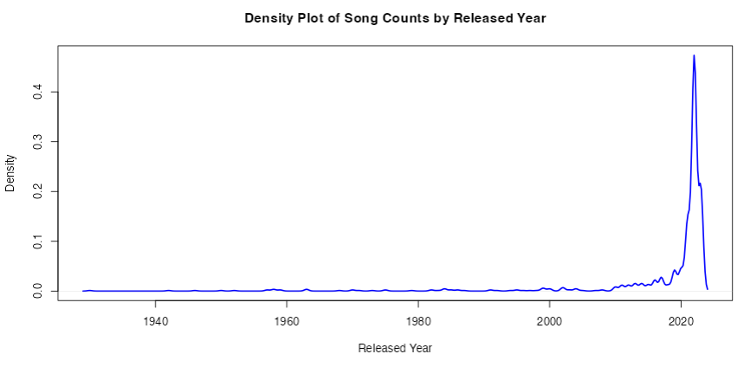
Timeline of Songs by Released Year
Majority of the songs in the data were released after 2020.

Slide 5
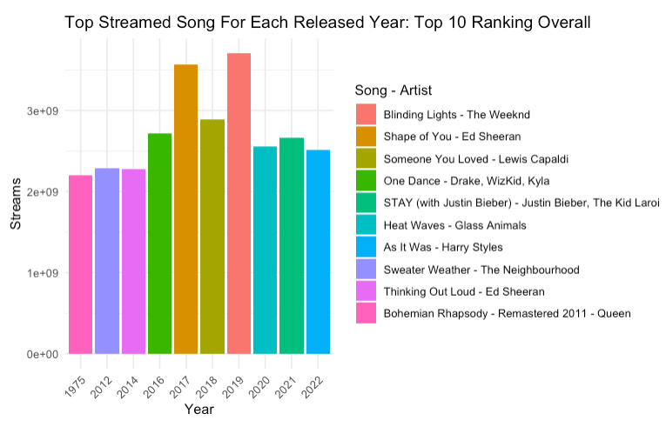
Top Streamed Song Each Year Ranked By Overall Streams
The top streamed songs came from 2017 and 2019.
Even though the list is dominated by recent years, Bohemian Rapsody - Queen from 1975 made the top 10.

Slide 6
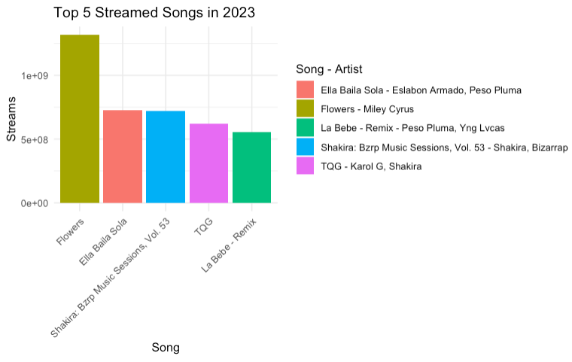
Top 5 Streamed Songs Each Year
2019 – 2023 each had a similar chart with the top streamed song dominating the rest of the top five.
Majority of other years saw a more equal distribution among the top 5.

Slide 7
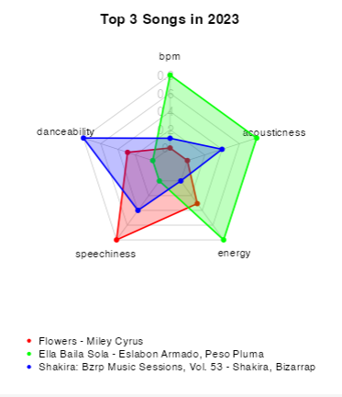
Audio Features of the Top Streamed Songs
The top 3 songs each year appear to be quite diverse in their musical features showing the variety in popular music.

Slide 8
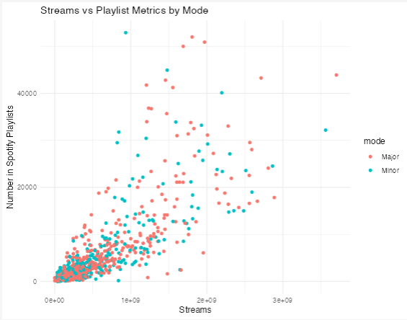
Influence of Playlist Appearances on Streams
Both major and minor modes of music appear equally represented on playlists and the number of streams.

Slide 9
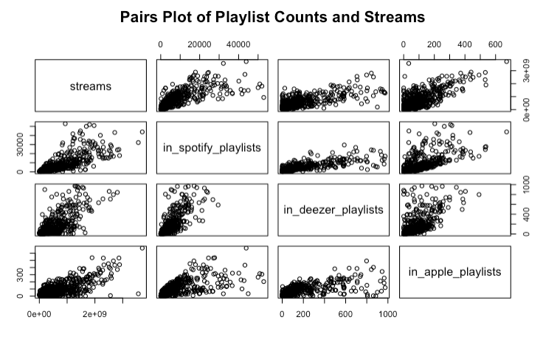
Relationship of Streams to Playlist Metrics
Streams had the most linear relationship to the metrics in Spotify, Apple, and Deezer playlists.
P-value and correlation metrics indicated I could create a linear model.
Chart appearances and audio features didn’t show much of a correlation to streams.

Slide 10
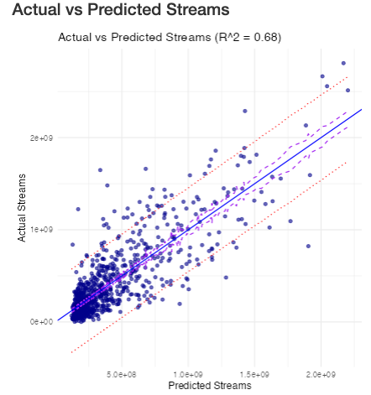
Linear Model to Predict Streams
Trained the linear model using the selected playlist inputs to predict total streams from same data.
R^2 resulted in 0.68. Removing outliers improved the model to 0.71, but I kept the original model.

Slide 11
Shiny App

Slide 12
Key Takeaways
The most popular songs don’t tend to share the same characteristics each year.
A variety of genres and artists are represented for the most streamed songs overall.
A higher number of playlist appearances in Spotify, Apple, and Deezer are most correlated to higher streaming numbers on Spotify.

Slide 13
Future Work
If other streaming platform metrics are available, compare the numbers for performance across other platforms.
If tour and concert data is available, compare their success to streams for the applicable years.
Check other indicators of streaming success.
Viral trends in social media or other media platforms to look for spikes in streams if stream data by date can be found.

Slide 14
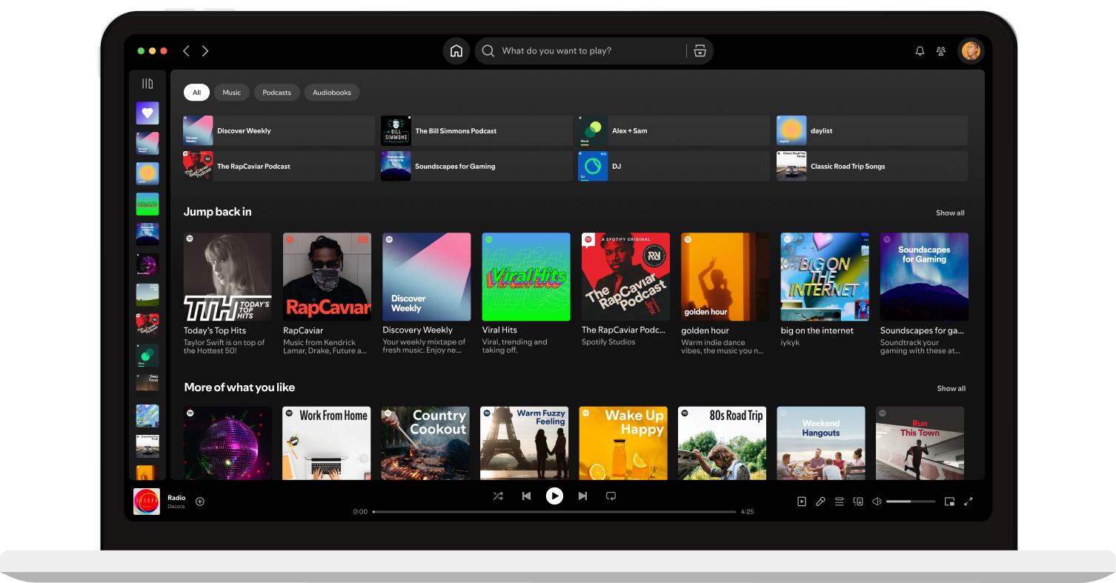
Questions

